Slide 1

My Summer Experience at MIT
By Charlene Valdez
Biology Major, Chemistry Minor
President of Ladies first math & science Club

Slide 2

What is the Amgen Scholars Program?
Mission:
  The Amgen Scholars Program provides hundreds of selected undergraduate students with the opportunity to engage in a hands-on research experience at many of the world's leading educational institutions.
  The Program seeks to increase learning and networking opportunities for students committed to pursuing science or engineering careers and to spark the interest and broaden the perspective of students considering scientific careers.
  Ultimately, the Program aims to increase the number of students pursuing advanced training and careers in the sciences.
  http://www.amgenscholars.com/us-program

Slide 3
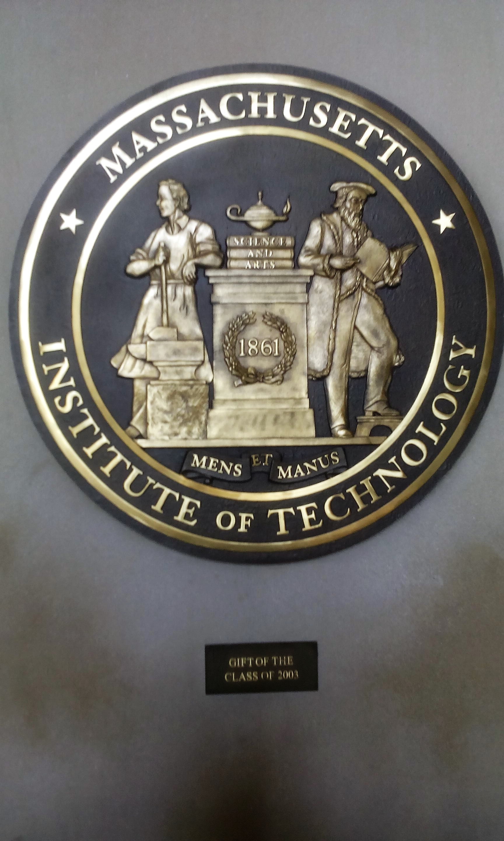
Experiences on Campus at MIT
This is the MIT seal that is located in a building known as Building 10. Each of the buildings on campus have a specified number. This is also true for students of different majors.
A Biology major at MIT would be considered to be a part of “Course 7”, a “Course” is what represents a major at MIT.

Slide 4
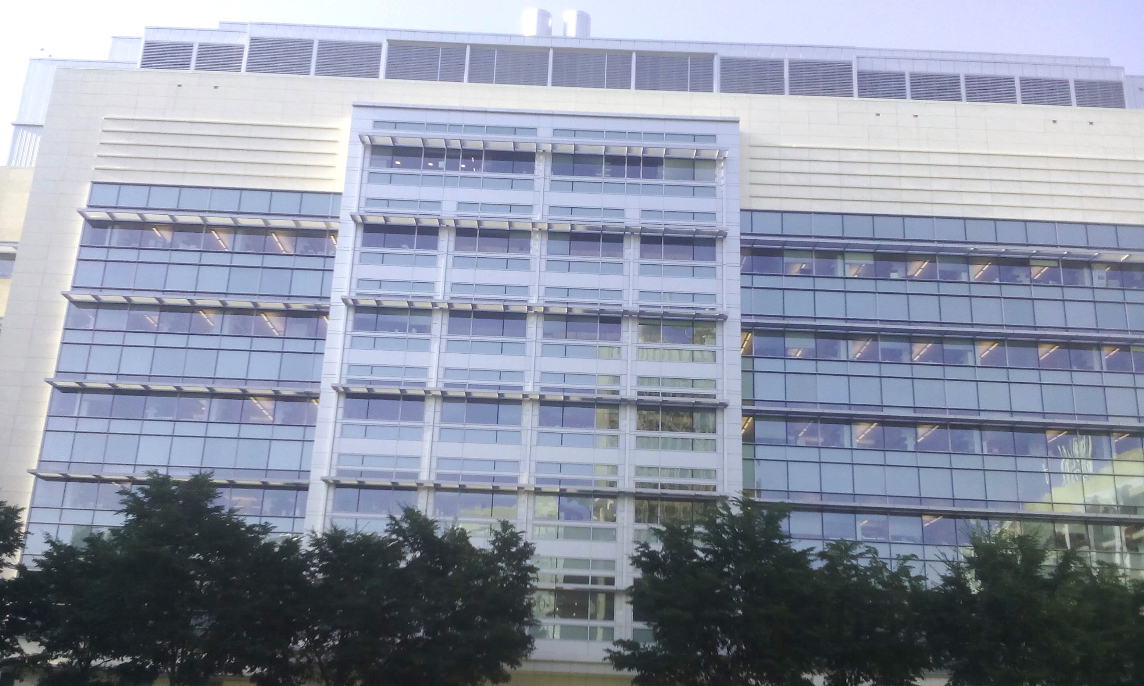
Experience in my MIT Lab
Image of the David H. Koch Institute for Integrative Cancer Research. This is the building I worked in during the summer.

Slide 5
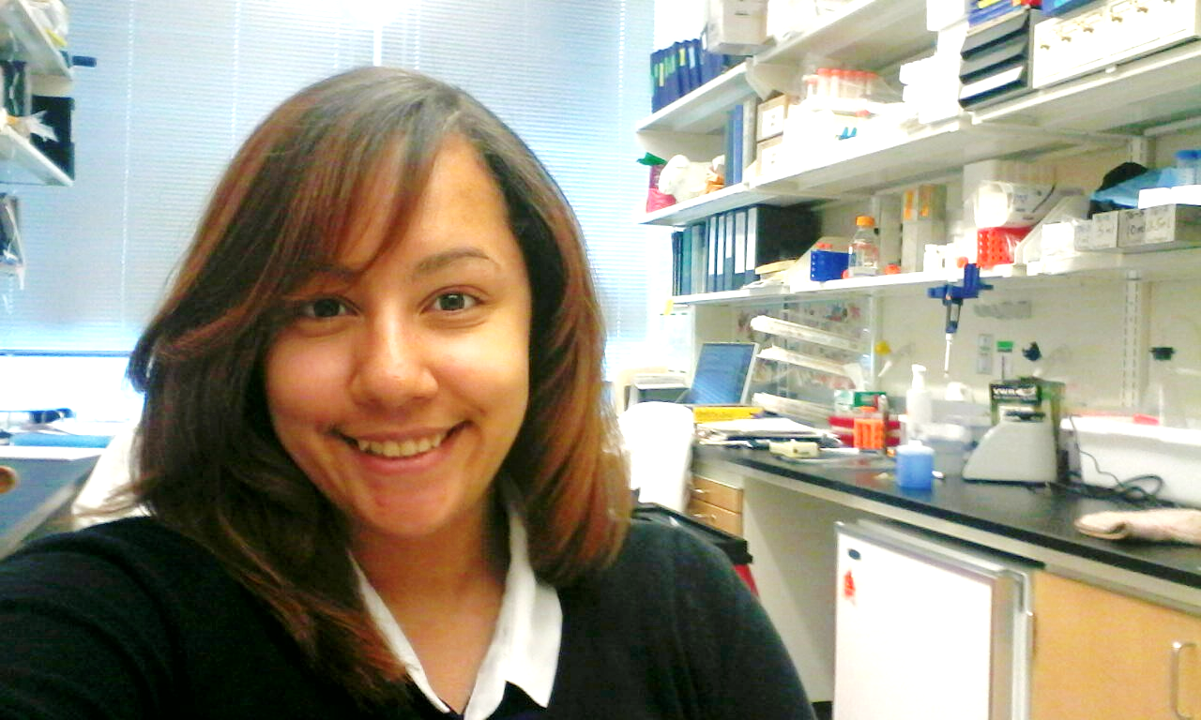
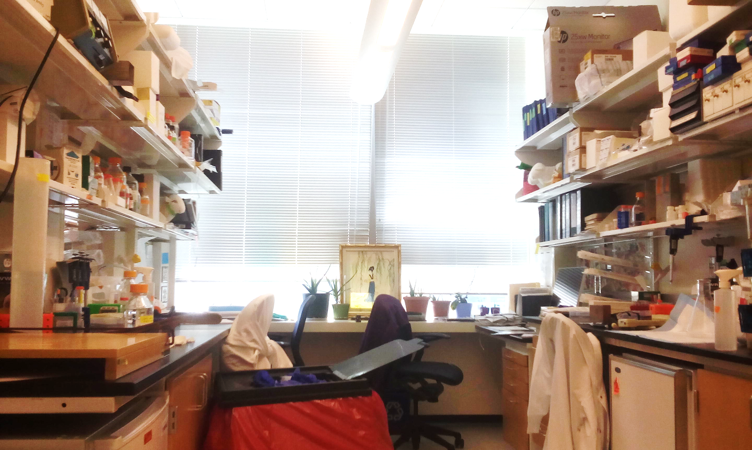
Experience in my MIT Lab
This is an image I took in the lab of Dr. Matthew Vander Heiden. The research lab I worked in this lab focused on Cancer Metabolism.

Slide 6
Experience in my MIT Lab
These are images of the 3D organoids (organ-like cells), I developed in the Vander Heiden Lab.

Slide 7
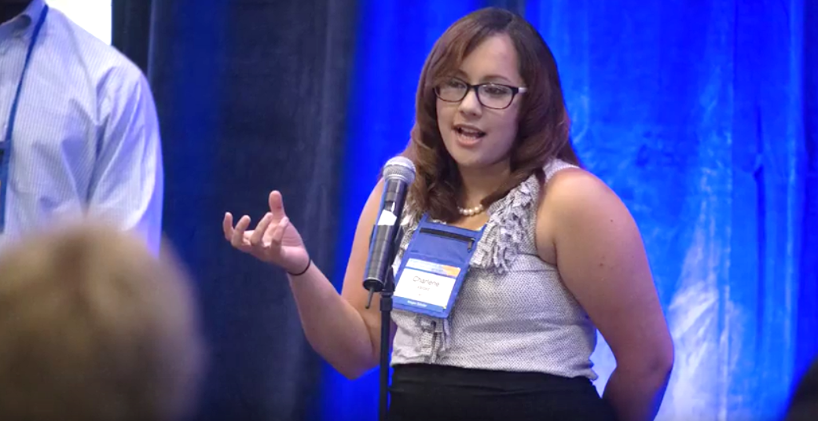
Amgen Scholars National Symposium
During the Amgen Scholars Research Symposium at the University of California in Los Angeles (UCLA), I was granted the opportunity to speak on behalf of the MIT Amgen scholars during the opening ceremony for the symposium.
I was asked to share my personal background, information about my home institution, my Amgen Scholar host site, and a brief summary of my research project.
There were only 10 students chosen, one from each Amgen US site, to participate in this introduction.

Slide 8
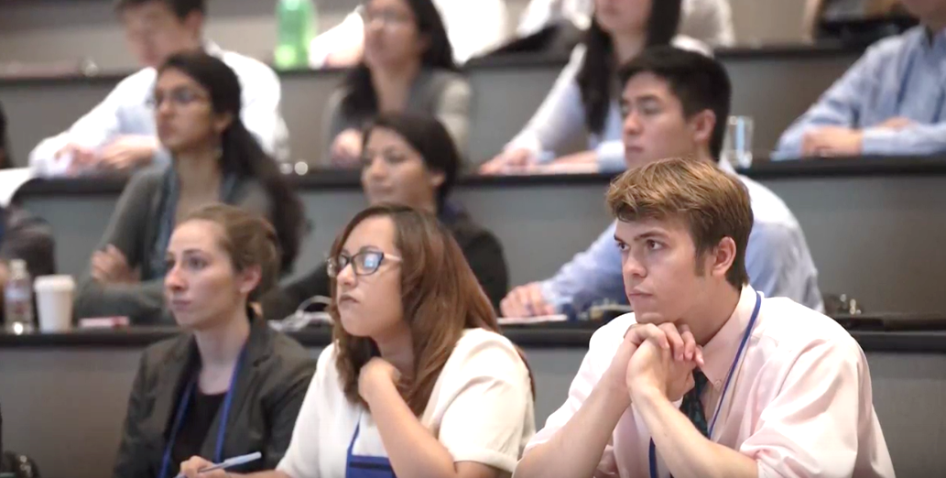
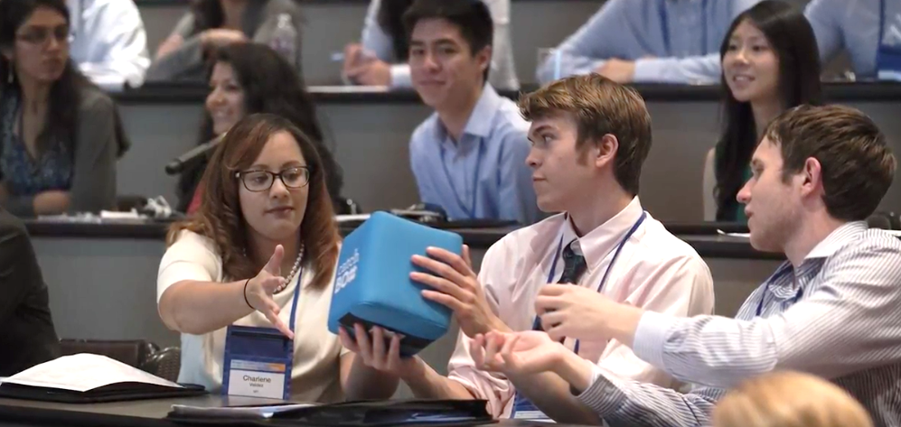
Amgen Scholars National Symposium
The Amgen Scholars Symposium also provided us with the opportunity to visit the Amgen Headquarters. More specifically, we were able to attend various talks discussing topics such as Cancer Biology, topics related to Biomedical Engineering, Cell Signaling, Pharmacology, and so on.
The image above is a moment where students were able to sit in on a presentation given by a prominent member of the Amgen executive board, and share our thoughts on the companies work on drug development.

Slide 9
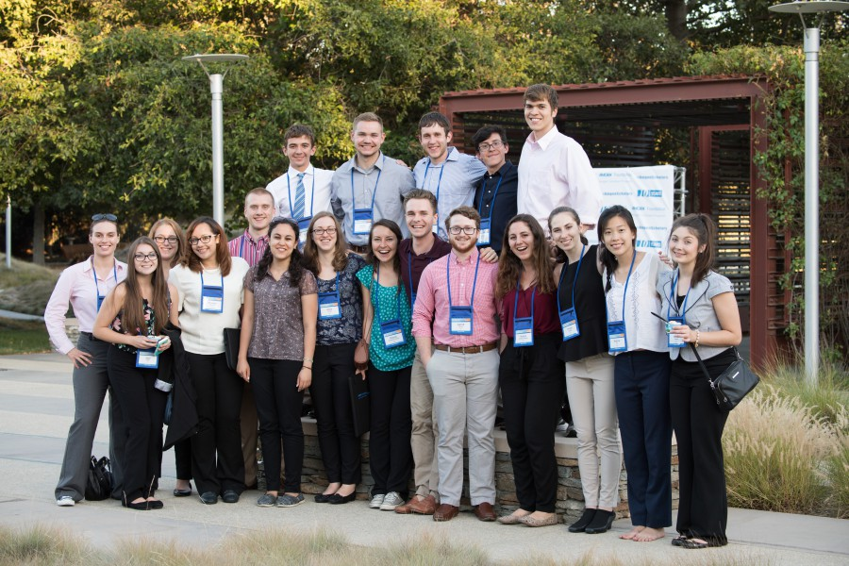
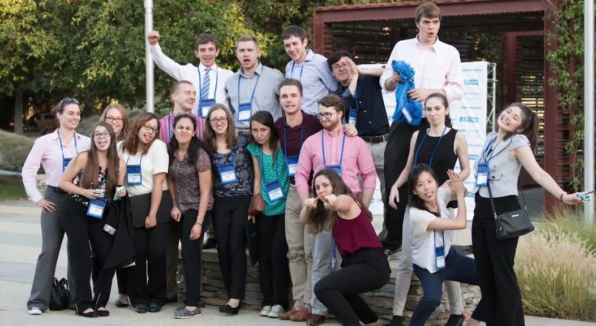
Amgen Scholars National Symposium
Image of me and my fellow colleagues from the MIT Amgen host site. This image was taken at the closing ceremony during the Amgen Scholars National Symposium. This image perfectly represented our cohort. I had an incredible time getting to know everyone in the MIT Amgen Scholars program.

Slide 10
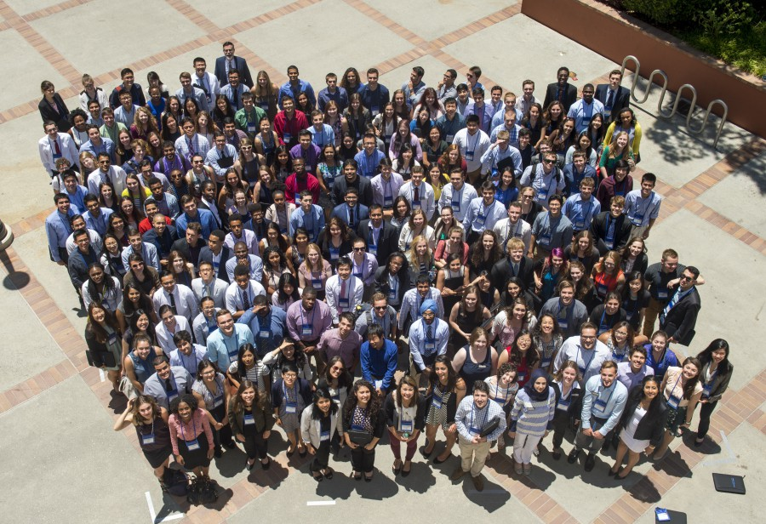
Amgen Scholars National Symposium
Group photo of all the Amgen Scholars in the program across the nation. This photo was taken at UCLA.
Note:
The square on the image can be removed. I used it as an indicator to show where I was.

Slide 11
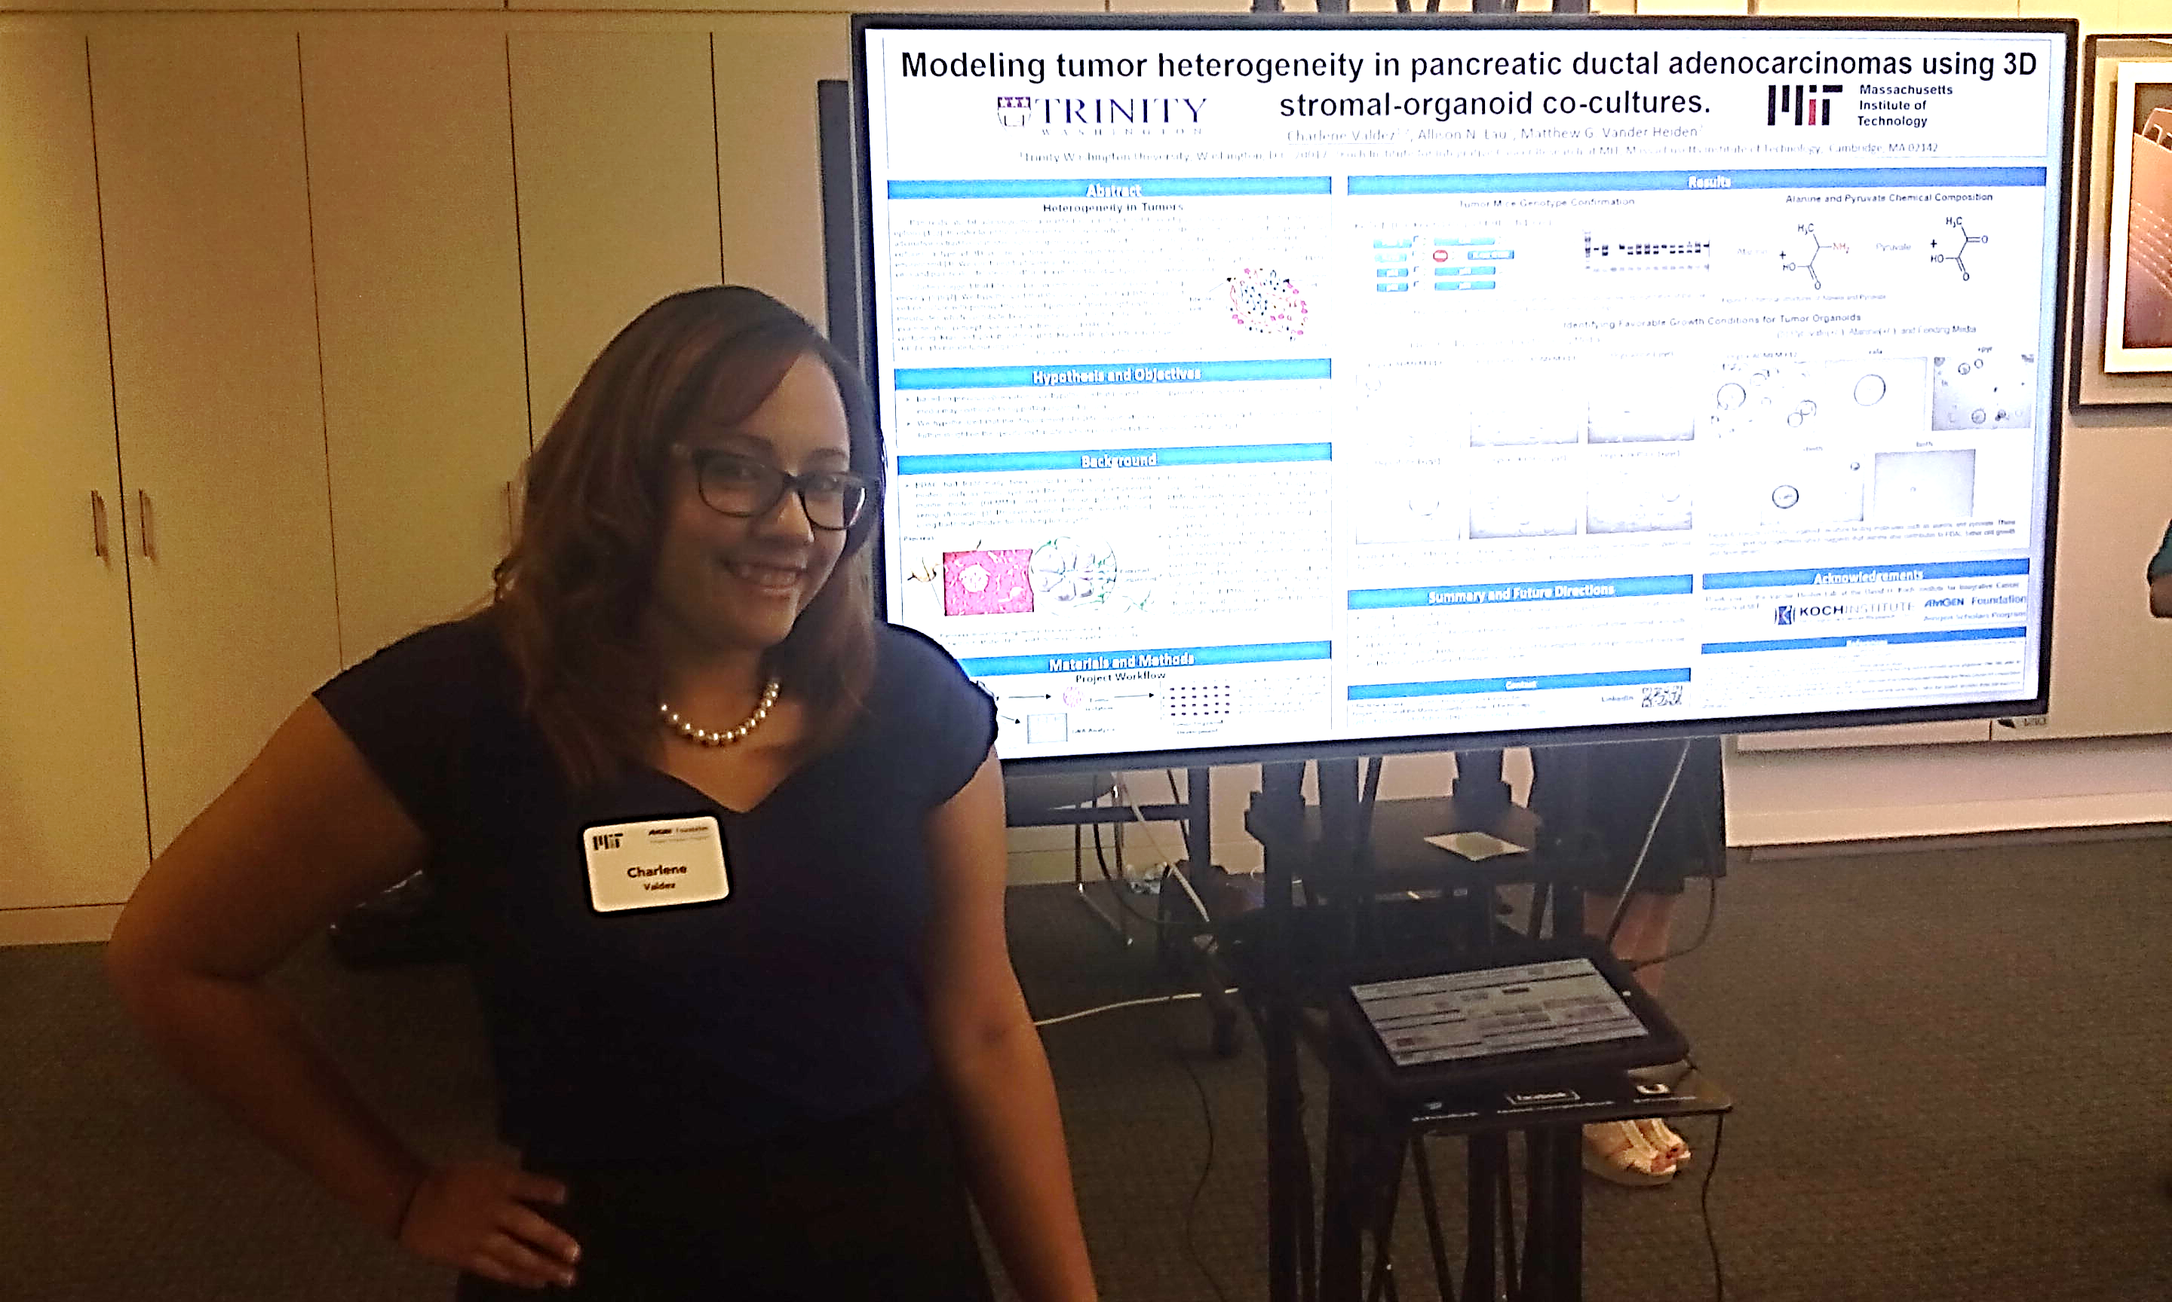
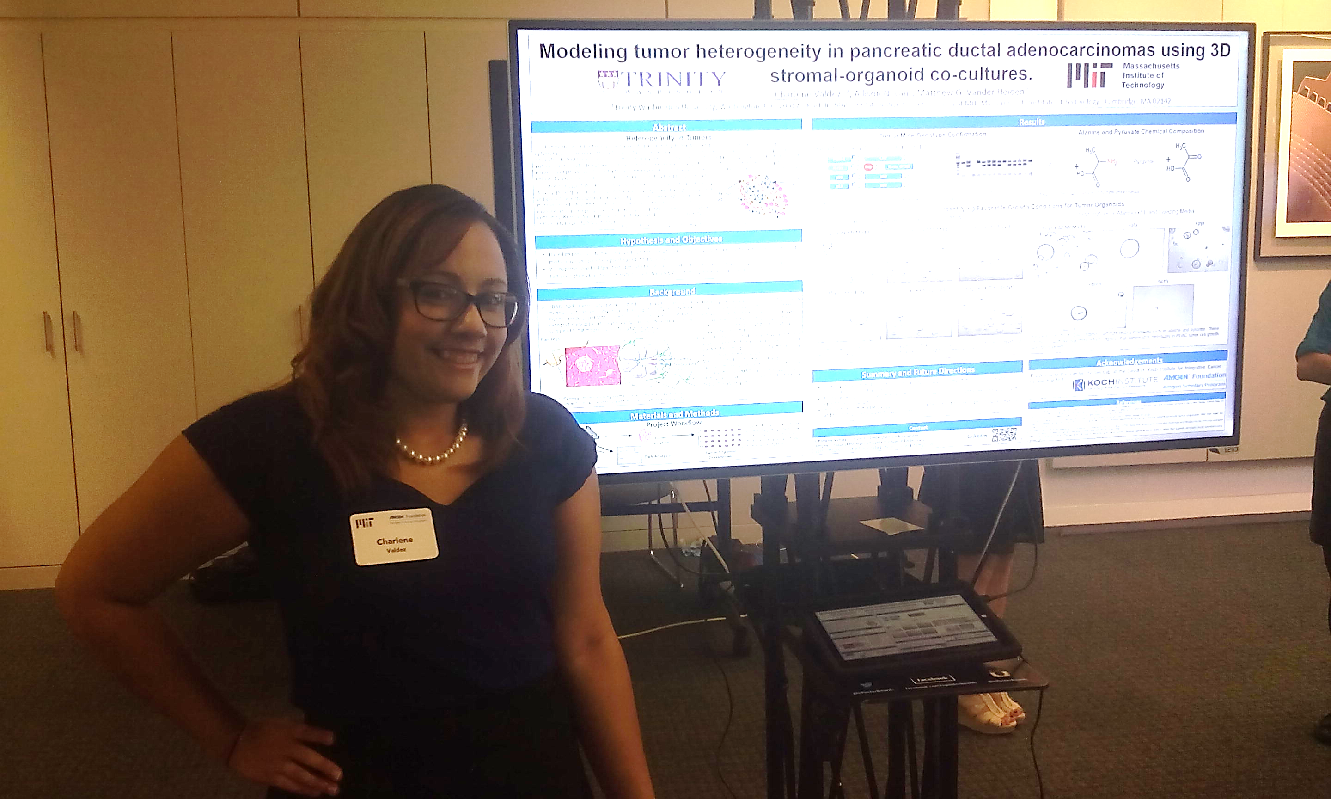
Amgen Scholars Symposium at MIT
This image was taken at the MIT Amgen Scholars research Symposium. We were allowed to create digital posters to present our data.
The poster is titled “Modeling tumor heterogeneity in pancreatic ductal adenocarcinomas using 3D Stromal Organoid cocultures”.
I was greatly complimented by my MIT peers and MIT faculty members who attended the symposium.

Slide 12
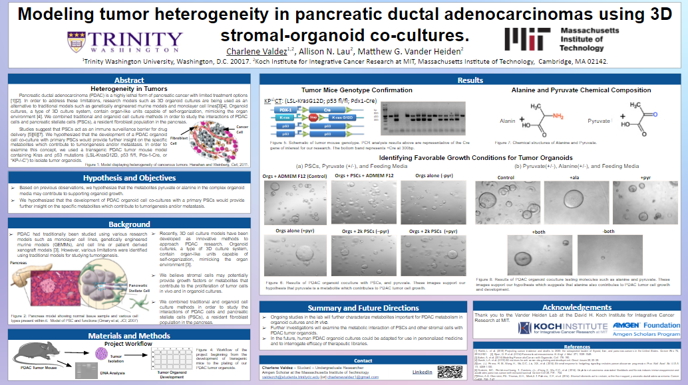
Amgen Scholars Symposium at MIT
Image of my poster. (just in case it wasn’t visible on the previous slide).

Slide 13
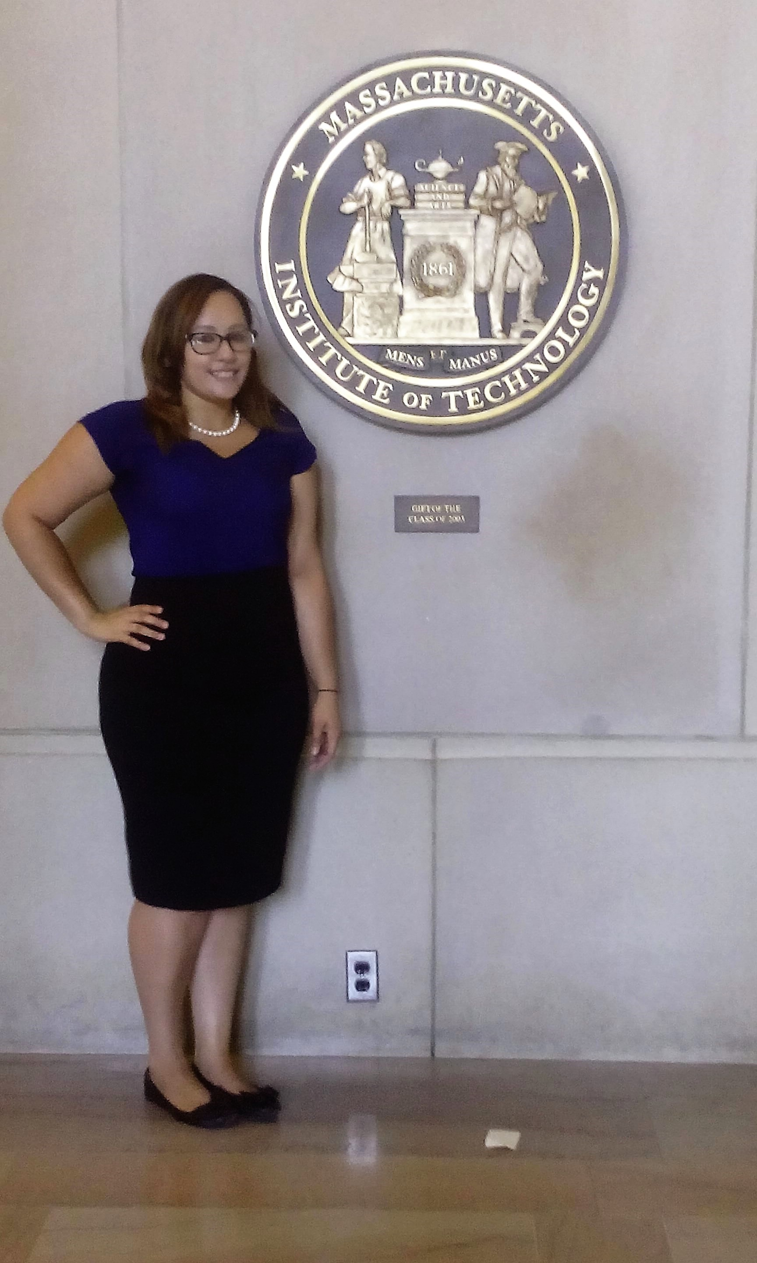
Amgen Scholars Symposium at MIT
Here is an image of me next to the MIT seal.
After finishing my poster presentation, I felt incredibly joy about the accomplishments I had throughout the summer. The memorable experience I had at MIT was officially complete.
I am thankful for the opportunities I had while in Cambridge, and I will never forget the incredible people I worked with during my summer.

Slide 14
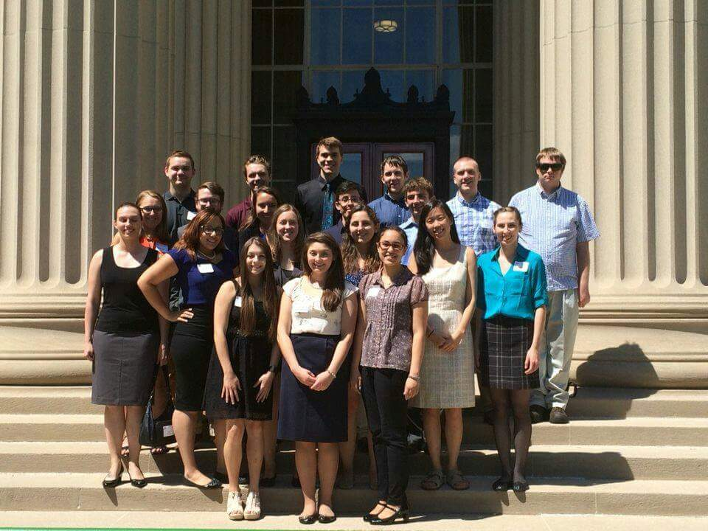
Amgen Scholars Symposium at MIT
Image of my colleagues and I again at the end of our poster session on MIT’s campus.
This moment was absolutely bittersweet since it was the last time we were able to join together prior to our departure from MIT.

Slide 15
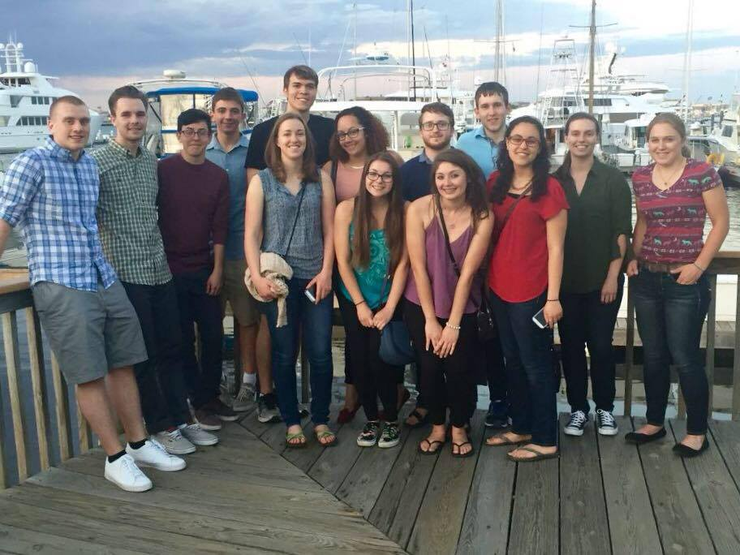

Fun in Boston
Left: A group photo of me with my cohort during an outing in Boston, MA. We went to visit the Boston Harbor and have dinner together.
Right: Me and two of my friends at a diner in Cambridge.

