Slide 1

Thriving in Perilous Times
Remarks for
Brown Edwards
Conference
June 1, 2015
President Patricia McGuire
Trinity Washington University
president@trinitydc.edu

Slide 2

My best days kayaking are mildly stormy days when I can feel the breeze on my face
and ride the waves that I can see coming at me.
My worst days kayaking are bright, sunny days when I get too far out from the shore;
lulled by the warmth I forget that the hot air builds toward the inevitable thunderstorm
when the wind kicks up suddenly coming down from the far away mountains,
and the waves start churning to whitecaps behind me and the harder I paddle the farther away I seem to be from the shore.
Lessons learned:
Paddle into the storm.
Every sunny day has a storm waiting to blow through.
Don’t be afraid, but always wear a PFD.
Know when to keep going, and when to seek shelter.

Slide 3

If you haven’t seen the storm coming in higher ed you’ve not been paying attention

Slide 4

ACADEMICALLY
ADRIFT
SCANDALS
GRAD
RATES
JOB
MARKET
TITLE IX
ATHLETICS
FEDERAL RATINGS
MOOCs
PELL
GRANTS
THE HIGHER EDUCATION BUBBLE
Moody’s
DEMOGRAPHICS
COLLEGE COST
TECH
ACCESS
ECONOMY
SWEET BRIAR
STUDENT
LOANS
AGING
FACULTY

Slide 5

5 Perilous Waves For Small Institutions
Enrollment Foundering
Drowning in Romance
Treading water on strategy
Rip Currents on Reputation
Pretending to be a Yacht when you’re paddling a small plastic boat

Slide 6
Enrollment Foundering
Sweet Briar illustrates the truth: without enough enrollment, no amount of endowment can “save” a private college or university if enrollment reaches a critical low point --- what is that point? How does an institution stop the slide in time? Could the Sweet Briar Story have turned out differently? How?
Enrollment is more than numbers; enrollment is the embodiment of mission
Mission = narrowly drawn set of characteristics of students but the large purpose of the institution in its outcomes
e.g., a modern women’s college should not be defined as having women only, but rather, as advancing opportunities for women’s education and advancement; men can participate in such a mission, just as students of many races enroll at HBCUs and students of many religions enroll at Catholic colleges
Understanding how to recast mission in terms of outcomes rather than input characteristics of students is an important part of any modern strategic plan
How do we develop enrollment strategies that are about outcomes rather than inputs? How do we capture new markets while staying faithful to mission?
Consider some key data points about changing demographics and enrollments from NCES (next pages)…. How do we embrace new markets while staying faithful to mission? How do we have that conversation on campus?

Slide 7
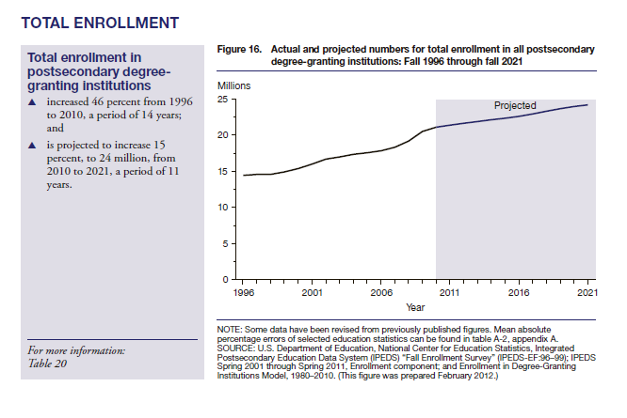
Source: Projections of Education Statistics to 2021
January 2013

Slide 8
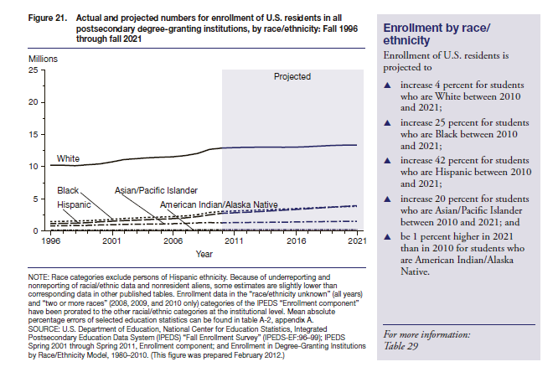
Source: Projections of Education Statistics to 2021
January 2013

Slide 9
Case Study Trinity: Paradigm Shift for Enrollment Growth
In the 1970’s and 1980’s, Trinity faced the kinds of enrollment challenges that many other colleges face today
Trinity recovered from the perilous times by diversifying the institutional model and welcoming a remarkably diverse population of low income students of color, completely changing demographics
Board leadership proved essential in the most challenging moments; Board insisted on a clear strategic plan and strongly supported management in the face of controversy and resistance
Middle States praised Trinity for remaining faithful to mission in the education of women, but also observed that sustaining the traditional mission was far more controversial than if Trinity had “gone coed”
Trinity in 2015 also experiencing an enrollment downturn like other institutions; the downturn is in professional and graduate programs, and because of the diversification of the model, Trinity is able to weather the downturn more coherently than in the past

Slide 10
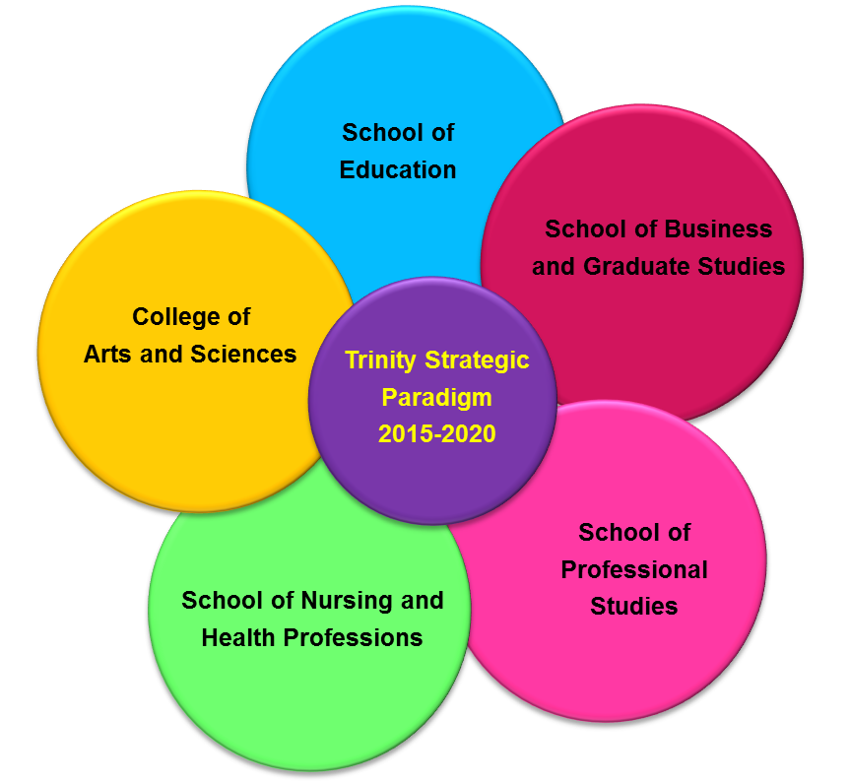
Trinity’s Diversified University Model
5 Academic Units
Central Support Services
Finance – Operations - Advancement
Academic and Student Services
Admissions and Enrollment Services

Slide 11
Trinity’s Strategic Plan
Envision Trinity 2020
Goal 2:
Financial Performance
Goal 9:
Quality, Outcomes, Performance Indicators
Goal 3:
Program Development
Goal 8:
Services for Students and Community
Envision Trinity 2020
Goal 1: Enrollment
Goal 7: Intellectual and Informational Resources
Goal 4: Technology
Goal 10: Facilities
Goal 5:
Human Resources
Goal 6:
Management Capacity

Slide 12
Founded in 1897 as one of the nation’s first Catholic women’s colleges, Trinity grew and diversified over the last 25 years to become a small university with five academic units.
Trinity maintains the historic women’s college as the College of Arts and Sciences (CAS) now enrolling more than 1000 women, while also enrolling women and men in the School of Nursing and Health Professions (NHP), School of Education (EDU), School of Professional Studies (SPS) and School of Business and Graduate Studies (BGS).
Trinity enrolls about 2,200 students in 2015. The student body is 70% African American, 20% Hispanic, and many students have immediate international heritage. Trinity enrolls a distinctively low income population of students from the District of Columbia and nearby counties. 85% of this year’s first year students are Pell Grant recipients, and the median family income is $25,000.

Slide 13
How Does Trinity Do It? (Mission, Strategy, Programs)
Steer with the Strategic Plan
Challenge conventions (not drowning in romance!)
Mission
Liberal arts AND professional studies
Women’s college AND welcome men
Catholic college AND interfaith hospitality
Delivery Systems
On campus AND off-site AND hybrid delivery
Full-time, Part-Time, Evenings, Weekends
Associate, Baccalaureate, Masters, Continuing Ed
Programs
Refocus on workforce development and career outcomes
Health Professions
STEM programs
Psych and Counseling
Communications, Criminal Justice, Business
All rooted in liberal arts but with clearly defined outcomes

Slide 14
How Does Trinity Do It? (Finance and Operations)
Manage the Money!
Manage Discount Rate (no more than 40%)
Control Spending on Frills (who paid for those cookies?
Invest in what will bring good returns
Dis-invest in non-performers
Relentless Focus on Enrollment Management
Deliver High Quality Services
Removing barriers to retention and satisfaction
Invest in Facilities and Technology When It Makes Sense for Enrollment Growth Strategy
Avoid the shoals through strong risk management
Ignore the Yachts

Slide 15
Perils: Drowning in Romance
Risk Avoidance v. the Courage to Change
Many institutions do not take bold steps to create change because of fear of “upsetting the alumni” or alienating donors; but the thing we should fear most is breaching our duty to sustain the institution as a matter of stewardship for all graduates, students and the public good
Shared Governance and Dithering
“Shared governance” is meaningless if there is no shared responsibility; decisions cannot be allowed to take months and years; the most important thing a president must do is to make the right decisions, which are not always the most popular decisions; consultation and collaboration do not mean blocking results
“If Only The President Would…”
Too many institutions suffer in a quixotic belief that if only the trustees found the right president, the “golden age” will return; in the same way, “if only the president would…” hire the right Admissions staff, e.g., the problems would go away; presidents are not curators of museums; the president’s job is to provide the leadership to articulate the future possibilities, motivate the community to move toward that vision, and organize the resources to make it achievable

Slide 16
Perils: Dithering on Strategy
Too many institutions confuse process with results; too many yellow and pink stickies on walls, not enough actual action steps that can lead to measurable and sustainable institutional progress
Boards must hold presidents accountable for managing the strategic plan for continuous growth, assessment and change; the absence of change means the institution is stagnating
Beware “Big Fix” Promises
Some of the most dangerous ideas out there urge institutions to drive up their discount rates as a means to build enrollment, believing that volume will levelize the net tuition results; this is a dangerous strategy, not a well-considered risk!
We can’t buy our way out of the enrollment problem, we have to build the solutions through effective institutional change
Aligning programs with market opportunities is the most necessary and most effective strategy to build enrollments for fiscal health

Slide 17
Rip Currents on Reputation
Reputational Threats:
Sexual Assault Incidents
Race, Gender, Sexual Orientation, Church Relations, other Identity and Mission-related issues
Athletics
Child Protection
Academic Fraud or Poor Outcomes
Federal Ratings/Private Rankings/Moodys
Safeguarding Reputation: Risk Management 101!

Slide 18
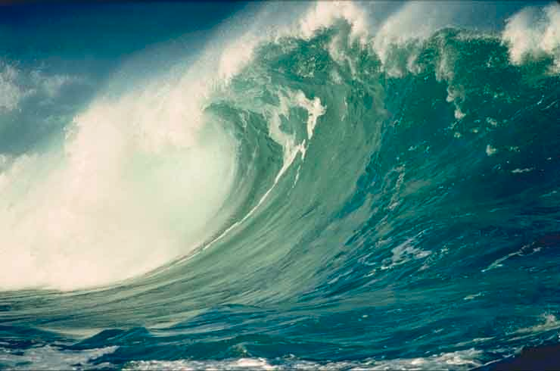
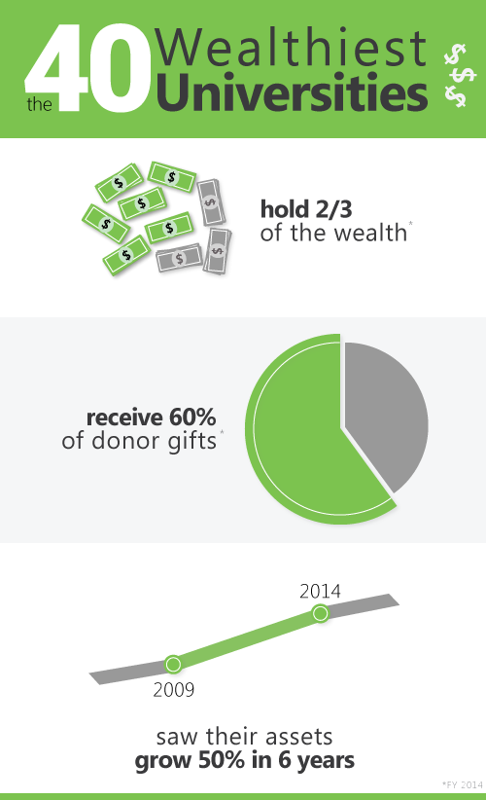
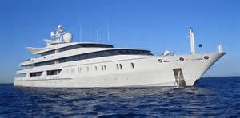

YACHT ENVY (Know the capacity and limits of your boat!)
Graphic from insidehighered.com “
Widening Wealth Gap” by Kellie Woodhouse,
May 21, 2015

Slide 19

To Thrive in Perilous Times:
Focus on Mission, but Move Mission with Markets
Root Strategy in Clear and Measurable Business Objectives
Diversify, Diversify, Diversify
Share governance prudently (a little shared governance goes a long, long way)
Take every well-considered risk
Focus on returns on investments, not costs alone
Question the Cookies
Embrace Risk Management as Cost Management
Beware Yacht Envy: Be What YOU are, not what others wish you to be
Hard times are not end times: use downturns as springboards for innovation

Slide 20

With practice and serious preparation,
we can even learn to enjoy the risks!
We can thrive in perilous times!

