Slide 1

Sustaining Soul While Shifting Paradigm:
Trinity’s Journey Through Transformation
Remarks to the USA Funds Symposium
February 21, 2013
President Patricia McGuire
Trinity Washington University
Washington, DC

Slide 2
In 1991, a Middle States reviewer noted that Trinity’s choice to sustain its historic mission focus on women was harder and produced more dramatic change than if Trinity had simply “gone coed.”
The reviewer was quite right. Trinity’s commitment to sustaining the “soul” of the institution in mission triggered a paradigm shift in populations, programs and services that continues to this day.

Slide 3
Trinity’s enrollment of full-time traditional undergraduates grew
from 19 students on opening day in 1900
to the peak in 1968 at 966 students.

Slide 4
From a high of 966 students in 1968,
Trinity’s full-time undergraduate enrollment
declined to 323 in 1993. This still all-female population
is now enrolled in the College of Arts and Sciences

Slide 5
Trinity’s full-time undergraduate enrollment (CAS) grew again
from 323 in 1993 to 1038 in 2012 but many changes
were necessary to trigger this renaissance. And even 1000 full-time students today
would not be enough to sustain institutional quality and innovation.
Strategic enrollment goals call for a combined enrollment of 3,000 in all programs.

Slide 6
As early as 1966 Trinity began to add new enrollment elements,
and the addition of the coeducational M.A.T. (now the School of Education)
helped to support the institution in the years when traditional enrollment declined.

Slide 7
Starting as the Weekend College in 1985, Trinity built programs
for a new population of working adults in the Washington region. Originally
all women, the School of Professional Studies is now coeducational, offering
associate, baccalaureate and masters degrees in professional fields.

Slide 8
In 2007 Trinity added Nursing, now the School of Nursing and Health Professions,
in response to regional workforce needs and to provide a career pathway
for students from local communities into local healthcare providers.

Slide 9
“Why are we trying so hard to “reclaim” a population that has moved on? The SNDs founded Trinity to offer access to higher education for women who face barriers. There are thousands of women at our doorstep who still face huge barriers, who need a Trinity education so very much”
--- a Sister of Notre Dame during strategic planning discussions circa 1992

Slide 12
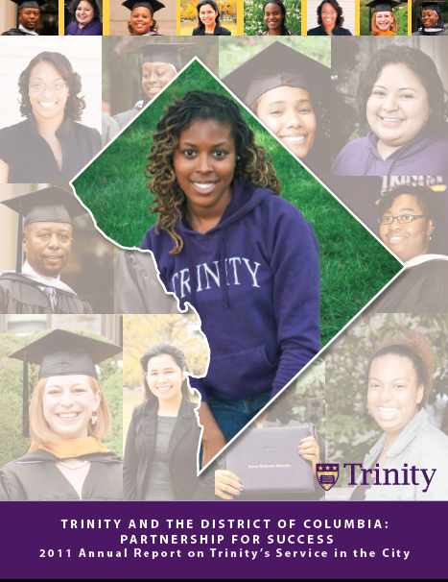

Slide 13
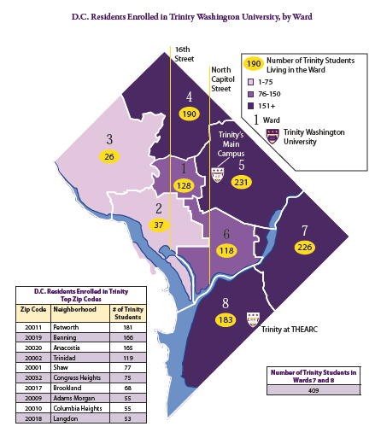

Slide 14
TRINITY STRATEGIC PARADIGM 2013
SCHOOL OF
EDUCATION
-------------------------------------------------
TEACHER PREP, SCHOOL ADMIN
AND COUNSELING PROGRAMS
COEDUCATIONAL
EVENING AND WEEKEND
POSTGRADUATE PROFESSIONAL
DEVELOPMENT PROGRAMS
SCHOOL OF
PROFESSIONAL
STUDIES
-----------------------------------
PROFESSIONAL PROGRAMS
FOR WORKING STUDENTS
COEDUCATIONAL
EVENING AND WEEKEND
ON AND OFF-SITE
ONLINE AND CLASSROOM
COLLEGE OF
ARTS & SCIENCES
--------------------------------------------
WOMEN’S COLLEGE
WEEKDAY/FULL-TIME
LIBERAL ARTS
BACCALAUREATE
ATHLETICS
CO-CURRICULAR
LEARNING PROGRAMS
SCHOOL OF NURSING AND HEALTH PROFESSIONS
________________________
COED
NURSING BAC + MASTERS
OT, PT, OTHER

Slide 15

Trinity Mission Statement
Trinity is a comprehensive university offering a broad range of educational programs that prepare students across the lifespan for the intellectual, ethical and spiritual dimensions of contemporary work, civic and family life.
Trinity’s core mission values and characteristics emphasize:
Commitment to the Education of Women in a particular way through the design and pedagogy of the historic undergraduate women’s college, and by advancing principles of equity, justice and honor in the education of women and men in all other programs;
Foundation for Learning in the Liberal Arts through the curriculum design in all undergraduate degree programs and through emphasis on the knowledge, skills and values of liberal learning in all graduate and professional programs;
Integration of Liberal Learning with Professional Preparation through applied and experiential learning opportunities in all programs;
Grounding in the mission of the Sisters of Notre Dame de Namur and the Catholic tradition, welcoming persons of all faiths, in order to achieve the larger purposes of learning in the human search for meaning and fulfillment.

Slide 16
“The team recognizes the impressive congruence of Trinity in 2006 with the original vision of Trinity’s founders in 1897.
“The team admires and commends the University’s rejection of the notion that paradigm shift means abandonment of historic mission.
“Rather, we discover in the work and vitality of Trinity of 2006, a most obvious continuity with Trinity’s 110 year old mission expressed with a renewed relevance and vigor….”
(2006 Middle States Team Report for Trinity, p. 5)

Slide 17
Realities: First Year Trinity Students Fall 2012
75% of entering first year students in Fall 2012 are Pell eligible
$25,000 is the approximate median family income
25% of first years estimate their family income at $10,000 or less
75% of first years identify as African American, 20% as Hispanic
Majority are self-supporting
Most work more than 20 hours per week, many work 40+ hours
About 15% of first year young women have children already
About 40% have health issues that can impede academic progress
Math, writing, critical reading skills are deficient
Knowledge of “the academic vocabulary” and culture is limited

Slide 18
Strategies for Student Success at Trinity: Academic
Curriculum and Pedagogy
1. Assessment: Every student is assessed at entrance for Math, Writing and Critical Reading
2. Engagement: Every first year student has a learning community with no more than 18 other students, led by a senior member of the faculty.
3. Specialists: Specialists in the gateway Math, Critical Reading and Writing courses teach the gateway courses
4. Technology: Technology tools (Moodle, MyMathLab, others) support first year instruction.
5. Assessment Again: Instructional specialists assess the results of every course each semster and write aggregate reports of progress in the specific gateway areas.
6. Career Pathways: With the addition of Nursing, Occupational Therapy, Criminal Justice and other new majors with more specific career pathways, student have additional incentive for higher achievement in general education.
7. Internships: Internships and experiential learning link students to the workforce opportunities early and frequently.

Slide 19
Strategies for Student Success at Trinity: Support
Academic Support
Tutors and workshops: math, writing, critical reading. “Monday Mathematics” has proven to be an immensely popular method to engage reluctant students in additional informal instruction with faculty members.
Learning skills support: through the Academic Services Center students can access staff and programs that assist them with a wide variety of academic issues
Disabilities Support: Trinity’s support for students with disabilities keeps expanding
First Year Advising and Services: Success in the first year is crucial to the ultimate goal of timely completion. In addition to all of the other supports, Trinity’s first year experience program includes
    Professional Advising
    Entrance Assessment and Course schedule design
    Triage Program
    Intrusive Advising
    Attendance
    Health Assessment

Slide 20
Strategies for Student Success: Co-Curricular
Co-Curricular Support and Services
Health Services
Residence Life
Athletics
Campus Ministry
Traditions: Signs and Symbols of Belonging
Partnerships
1. College Success Foundation
2. College Access Program
3. KIPP, other charter schools, public schools, Catholic schools
4. Cristo Rey Network
5. Girl Scouts
6. Jumpstart

Slide 21
Successful Outcomes
A recent survey of Trinity graduates from 2002 to 2012 (survey still in process) points to these results: of those who have answered…
95% are currently employed with a median salary range of $60,000-$69,000
70% have pursued some graduate studies since graduation; 60% have completed graduate degrees and 36% are still enrolled for a total persistence/completion rate of 96% for graduate degrees; the graduate schools they have attended include universities such as Georgetown, the London School of Economics, American University, Howard University, the University of Pennsylvania, UMUC, Bowie, Towson, Phoenix and Trinity
Within one year of graduation, 78% reported that they were immediately employed and 32% were in graduate school
85% of respondents say that they are employed in the same or related field as their major, or in a different field by choice;
The most important knowledge and skills the respondents said they received from their Trinity education include excellence in written and oral communication, critical thinking and a deep sense of ethics.

Slide 22
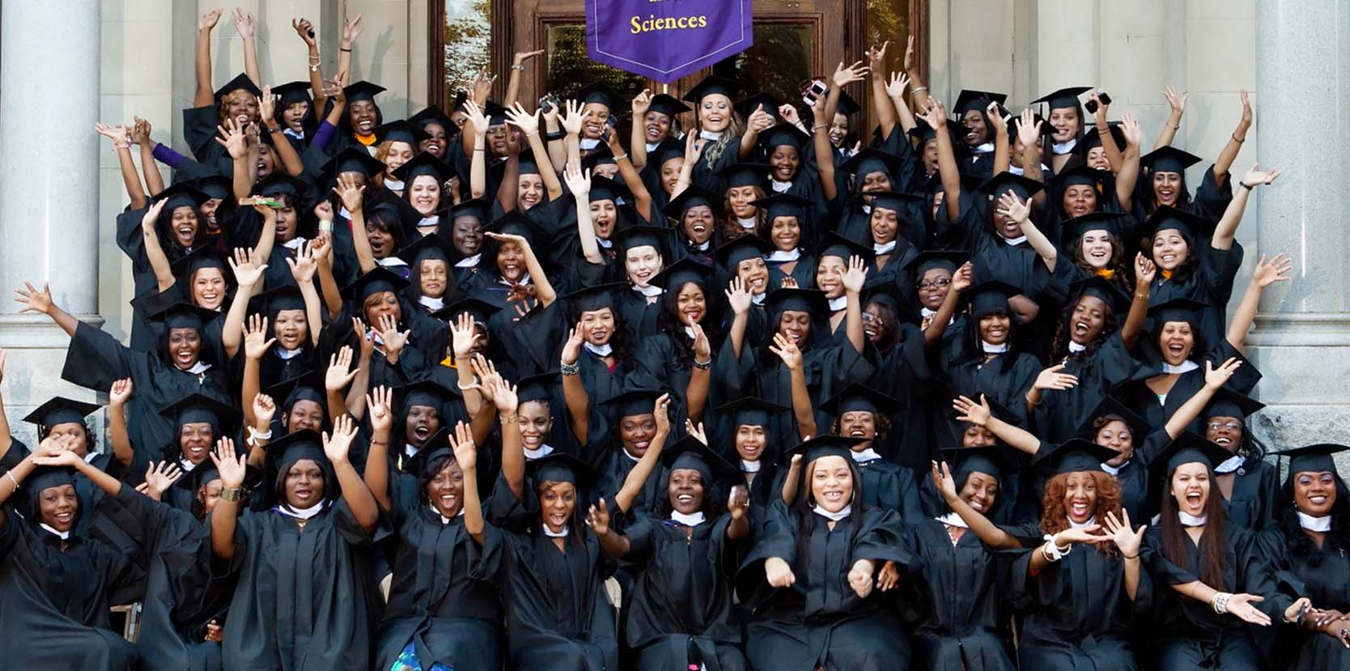
What better work can there be than to change lives through education?

