Slide 1

TRINITY TASK FORCE ON
ARTIFICIAL INTELLIGENCE
UPDATE
9/23/2026

Slide 2
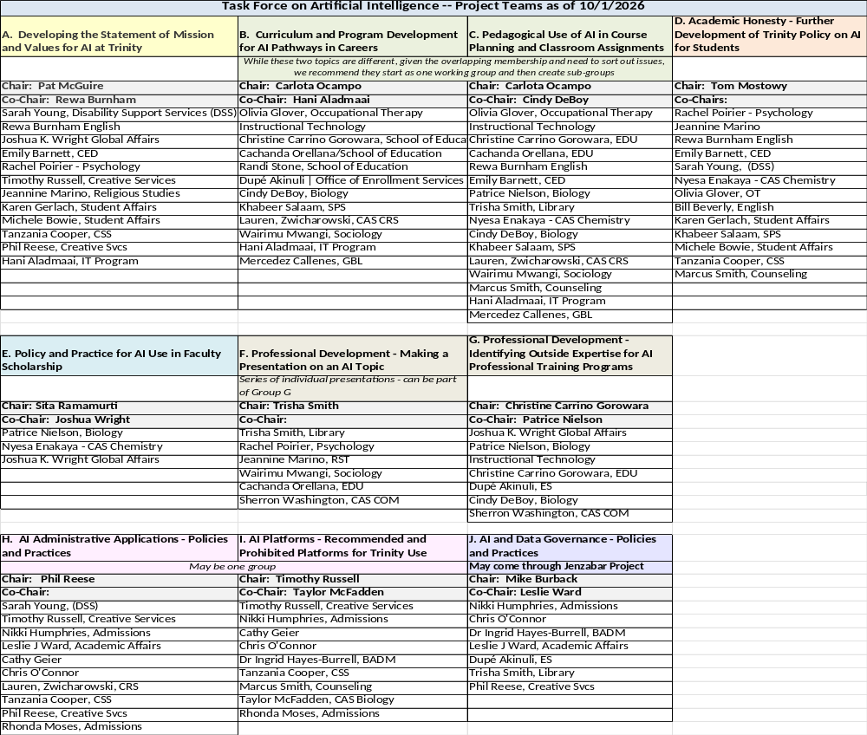

Slide 3
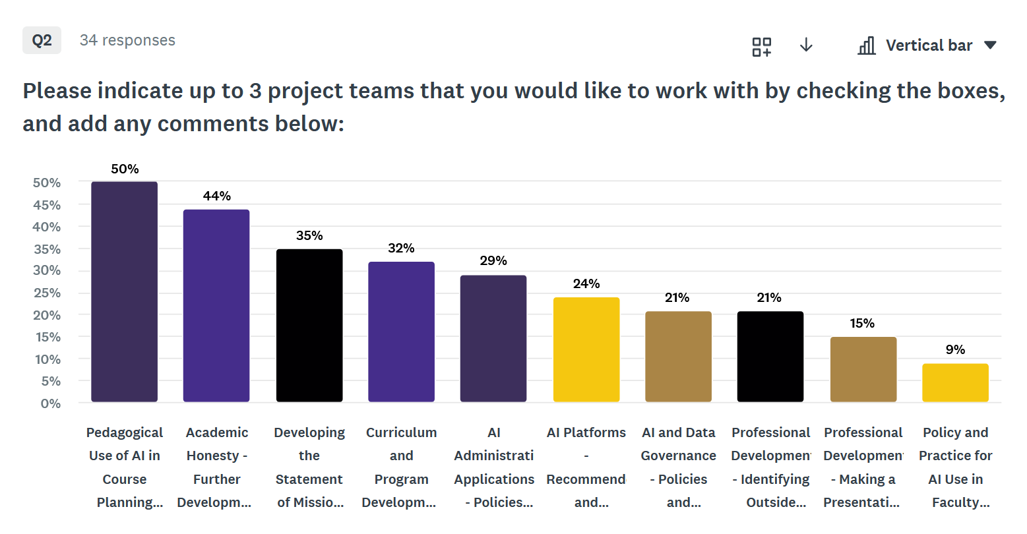

Slide 4
AI Task Force: Goals
Trinity’s Task Force on Artificial Intelligence will:
Develop of a clear statement, grounded in mission and values, on Trinity’s philosophy of the application of AI tools in teaching and learning, pedagogy and research, administrative work and communications.
Align of Trinity’s AI policy with social justice teachings set forth in Pope Leo’s encyclical on AI Magnificat Humanitas
Identify appropriate uses of AI tools in the work of faculty and staff, and prohibited uses
Identify the preferred AI tools/platforms for academic/administrative uses at Trinity
Implement ongoing professional development and education for faculty, staff and students to understand acceptable uses of AI in student work and prohibited uses
Make a specific statement on protection of private data and transparency in the use of AI tools
Clarify and expand the academic policy on AI as it relates to teaching and learning, with special emphasis on clarity for AI applications in student work, course development and pedagogy
Identify how AI is already being used in the major career pathways that Trinity students are entering, e.g., in healthcare, business, education, communications, and other professional fields, for the purpose of ensuring that each discipline is preparing students appropriately for the use of AI tools in professional life after Trinity
Continuous review of policy statements on AI, Academic Honesty, professional ethics and the use of AI in all phases of university work

Slide 5
September 23 Task Force First Meeting Agenda
Overall discussion of purpose and goals of the Task Force
Structure of the Task Force and Issues
When and How Will We Engage Students in the Task Force?
Issues from Readings and Current Media
Membership on the Project Teams
Expectations for Project Teams
  Co-leadership roles
  Open dialogue and exploration
  Research for Best Practices
  Draft Reports As Basis for Developing Trinity Statements, Policies and Practices
  Timetable, Mid-Course Check-in, External Help

Slide 6
Possible Timetable for Task Force
September 2026 Organize
October-November 2026 Project Team Meetings
- Reading and Learning
- PD Programs
December 2026 Check-in Task Force Meeting
January-February 2027 Finalize Project Team Research
March-April 2027 Draft Reports Finalized
May 2027 Report Out to Faculty
Fall 2027 Implementation – go to respective governance bodies for review and approval:
Policy Changes
Curriculum Changes

Slide 7
AI TASK FORCE PROJECT TEAMS AND TOPICS (Page 1 of 3)
TOPIC | TEAM MEMBERS | QUESTIONS FOR DISCUSSION | RELATIONSHIPS
Statement of Mission and Values for AI at Trinity | Faculty Staff Deans President | How do we craft a comprehensive statement on the use of AI at Trinity that incorporates Trinity’s mission, values and the student markets we serve? OUTCOME: Guiding statement for AI use | All
Curricula and Programs | Program Faculty and Chairs Deans Career Services | How is AI used in the career pathways our students will enter and how will programs adapt their curricula to prepare students for AI use in the workplace? OUTCOME: Programs develop and adopt curricular alignment strategies in relation to career pathways | CAP Committees Industry Partners
Pedagogy | Faculty Deans Moodle/Tech staff | How are faculty using AI in teaching, e.g., development of syllabi, creation of class assignments, in-class activities, etc. What are the recommended AI platforms? OUTCOME: Faculty develop and adopt a statement of recommended uses of AI in pedagogy, and parameters for what is acceptable and not acceptable use | CAP Committees Professional Development Committee
Faculty Research and Scholarship | Faculty | How are faculty using AI in their own professional research, writing and scholarship? OUTCOME: Faculty adopt statement of acceptable uses of Ai in scholarship | Unit faculties Professional Development Committee

Slide 8
AI TASK FORCE PROJECT TEAMS AND TOPICS (Page 2 of 3)
TOPIC | TEAM MEMBERS | QUESTIONS FOR DISCUSSION | RELATIONSHIPS
Professional Development | Faculty Staff | Internal: create a series of salons/webinars conducted by Trinity faculty and staff to educate all on AI developments External: identify providers (like “Quality Matters) that Trinity might retain for training OUTCOME: an ongoing comprehensive professional development program for the use and governance of AI tools at Trinity | Professional Development Committee Faculty Welfare Committee Senior Staff
Academic Honesty | Faculty Deans | How do we revise/update the current policy and practices concerning student use of AI to do more to help students to understand what is or is not permissible? Do AHRB policy and procedures need to change? OUTCOME: clarification and updated statement of policy and procedures for student mis-use of AI tools in their academic work | AHRB Unit faculties

Slide 9
AI TASK FORCE PROJECT TEAMS AND TOPICS (Page 3 of 3)
TOPIC | TEAM MEMBERS | QUESTIONS FOR DISCUSSION | RELATIONSHIPS
Administrative Applications | Staff | What are the uses of AI among administrative staff and what guidelines do we need to adopt to ensure appropriate use? OUTCOME: guidance statement for staff | Senior Executive Staff
AI Platforms | Faculty Staff | What are the AI platforms that Trinity should adopt as accepted for use throughout the Trinity community, and what policy statements should accompany the adoption? OUTCOME: List of adopted platforms and indications of what kinds of uses are acceptable for each | CAP Committees Unit faculties Senior Executive Staff Administrative Users
Data Governance | Tech Staff Faculty | What protections does Trinity need to implement to ensure the privacy of all of our data as more faculty and staff use AI tools? OUTCOME: Guidance statement on protection of data privacy | Senior Executive Staff Jenzabar Implementation Group

Slide 10
Conceptual Design
Staff Group
Inventory of administrative uses of AI
What are the patterns of AI usage that are cheating and how should the honesty policy be amended?
Recommendations for approved AI platforms
AI Task Force
Administrative Applications
Internal Professional Developmednt
External Professional Development
Academic Honesty
Adopted AI Platforms
Pedagogy
Faculty
Research + Scholarship
Data Governance
Curricula and Programs
Data Governance Group
Faculty
AHRB
AI Task Force:
Statement of Alignment with Trinity Mission and Values
What are the outside professional development programs that Trinity faculty and staff should attend?
Guidelines for privacy and protection of data when using AI applications – interface with Jenzabar conversion
Faculty presentations on some of the big AI issues in areas of expertise, e.g.
Dr. Marino – Magnifica Humanitas
Dr. Nielson – Environmental Impact
Mr. Aladmaai – Overview of AI Tools
Other Faculty – Pedagogy Examples
How should programs adopt/include AI issues related to the jobs and career pathways students will follow?
CAP COMMITTEES
Inventory/Illustrations of current practices for using AI pedagogy in teaching
Faculty Welfare Committee
Professional Development Committee
How are faculty using AI in their research and scholarship? Should they teach students these methods?

