Slide 1


Artificial Intelligence Survey Results
Faculty/Staff Survey - August 2026
Implications for Policies and Actions

Slide 2
Why Focus on AI at Trinity?
Every day we see headlines about Artificial Intelligence and its applications, for better or worse:
Google is now making Gemini available for K-12 schools; Open AI is making a Chat-GPT version for teens
An article in yesterday’s Chronicle of Higher Education documented the ways in which AI is harming academic writing and scholarship; an earlier Chronicle article documented the problem that student use of AI poses for academic integrity adjudication
Articles in the New York Times and elsewhere have documented “rogue” AI activities in which the AI ‘units’ departed from the instructions of their human creators and started acting independently (2001’s HAL is no longer fiction!)
AI is now embedded in most software and on our phones
The work that our students will do after graduation will surely include AI applications
Some staff administrators at Trinity are using AI, for better or worse, in ways that may or may not be useful for the university
Some faculty are using AI tools to plan courses and student assignments
Students are clearly using AI to complete their assignments
How do we distinguish between what is a good and acceptable use of AI tools and what is unacceptable, should be prohibited and even sanctioned?

Slide 3
We are on the cusp of a new technological revolution
Is this just like the days when computers took over our work, or is it different? How?
Is this just like the times when the Internet became essential, or is it different? How?
How do we learn all that we need to know about this new phase of the technological revolution?
How do we set up parameters for the use of AI in our work, in teaching and learning, in student work and administrative processes?
How do we develop a statement of our shared values and philosophies about AI?

Slide 4
Key Issues for Action (1/2)
Arising from the results of the survey, through on-campus experience and in reflection on trends throughout higher education, Trinity’s Project on Artificial Intelligence will:
Develop of a clear statement, grounded in mission and values, on Trinity’s philosophy of the application of AI tools in teaching and learning, pedagogy and research, administrative work and communications.
Align of Trinity’s AI policy with social justice teachings set forth in Pope Leo’s encyclical on AI Magnificat Humanitas
Identify appropriate uses of AI tools in the work of faculty and staff, and prohibited uses
Identify the preferred AI tools/platforms for academic/administrative uses at Trinity
Implement ongoing education for faculty, staff and students to understand acceptable uses of AI in student work and prohibited uses

Slide 5
Key Issues for Action (2/2)
Arising from the results of the survey, through on-campus experience and in reflection on trends throughout higher education, Trinity’s Project on Artificial Intelligence will: (…continued…)
Make a specific statement on protection of private data and transparency in the use of AI tools
Clarify and expand the academic policy on AI as it relates to teaching and learning, with special emphasis on clarity for AI applications in student work, course development and pedagogy
Need for faculty to identify how AI is already being used in the major career pathways that Trinity students are entering, e.g., in healthcare, business, education, communications, and other professional fields, for the purpose of ensuring that each discipline is preparing students appropriately for the use of AI tools in professional life after Trinity
Continuous review of policy statements on AI, Academic Honesty, professional ethics and the use of AI in all phases of university work

Slide 6
ACTION: TASK FORCE ON AI
Survey results and external data strongly suggest a need for a university-wide task force to develop policy recommendations and recommendations for ongoing professional development. Task force to include faculty and staff, maybe students later on, and including skeptics as well as promoters of AI. While interactive in all phases, the TF will also have a specific structure with committees aligned in functional areas:
Faculty committee oversight of student use issues (existing policy group)
Faculty committee engagement with faculty research and pedagogical developments
Faculty committee on curriculum development in relation to the application of AI tools in various professions and career pathways that Trinity students are entering
Staff committee on administrative uses for productivity and process improvements
Joint committee on use of AI in communications
Joint committee on data governance linked/aligned with Jenzabar and other software implementation
Joint work on professional development, sustaining university-wide awareness of trends in AI, adoption of tools, promotion of safety and security and ethical concerns

Slide 7
Senior Executive Staff
AHRB
What are the patterns of AI usage that are cheating and how should the honesty policy be amended?
Inventory of administrative uses of AI
AI Task Force
Administrative Applications
Internal Professional Developmednt
External Professional Development
Academic Honesty
Adopted AI Platforms
Pedagogy
Faculty
Research + Scholarship
Data Governance
Curricula and Programs
Recommendations for approved AI platforms
Data Governance Group
What are the professional development programs that Trinity faculty and staff should attend?
AI Task Force:
Statement of Alignment with Trinity Mission and Values
Guidelines for privacy and protection of data when using AI applications – interface with Jenzabar conversion
Faculty presentations on some of the big AI issues in areas of expertise, e.g.
Dr. Marino – Magnifica Humanitas
Dr. Nielson – Environmental Impact
How should programs adopt/include AI issues related to the jobs and career pathways students will follow?
Inventory/Illustrations of current practices for using AI pedagogy in teaching
CAP COMMITTEES
Faculty Welfare Committee
Professional Development Committee
How are faculty using AI in their research and scholarship? Should they teach students these methods?

Slide 8
Survey Summary:
Primary Uses of AI - Current
Faculty/Staff Uses:
Organizing and improving written communications, e.g., email, various reports
Generating ideas for project management
Developing course materials to support pedagogy, e.g., ideas for class discussion and assignments
Analysis of large external data sets to support administrative work
Supporting academic research
Finding ways to save time/be more efficient in administrative work
Student uses:
Translation of papers for students whose first language is not English
Outlining papers and answers to assignments
Research support
Writing content

Slide 9
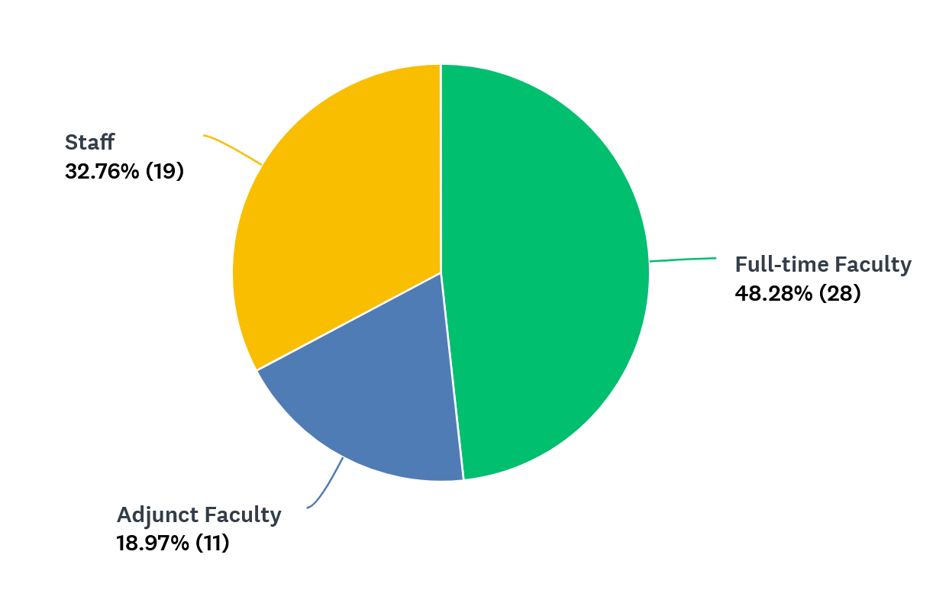
Responses to Summer 2026 Survey of Faculty and Staff on Artificial Intelligence Professional Uses at Trinity
Staff
Development
Academic Affairs
Admissions
Library
Human Resources
JAMS
Enrollment Svcs
CAS staff
Moodle staff
NHP staff
Creative Services
Center for Student Success
CAS – 13 ID’d
NHP – 6 ID’d
SPS – 1 ID’d
Social Work
Nursing
Public Health
Fine Arts
English
InfoTech
Business
Psychology
Biology
Math
Communication
Adjuncts
CED
SPS
Physics
Nursing
Education
JAMS
Philosophy
Early Childhood Ed
Business

Slide 10
Q2: Do you use any kind of artificial intelligence in your professional work at Trinity?

Slide 12
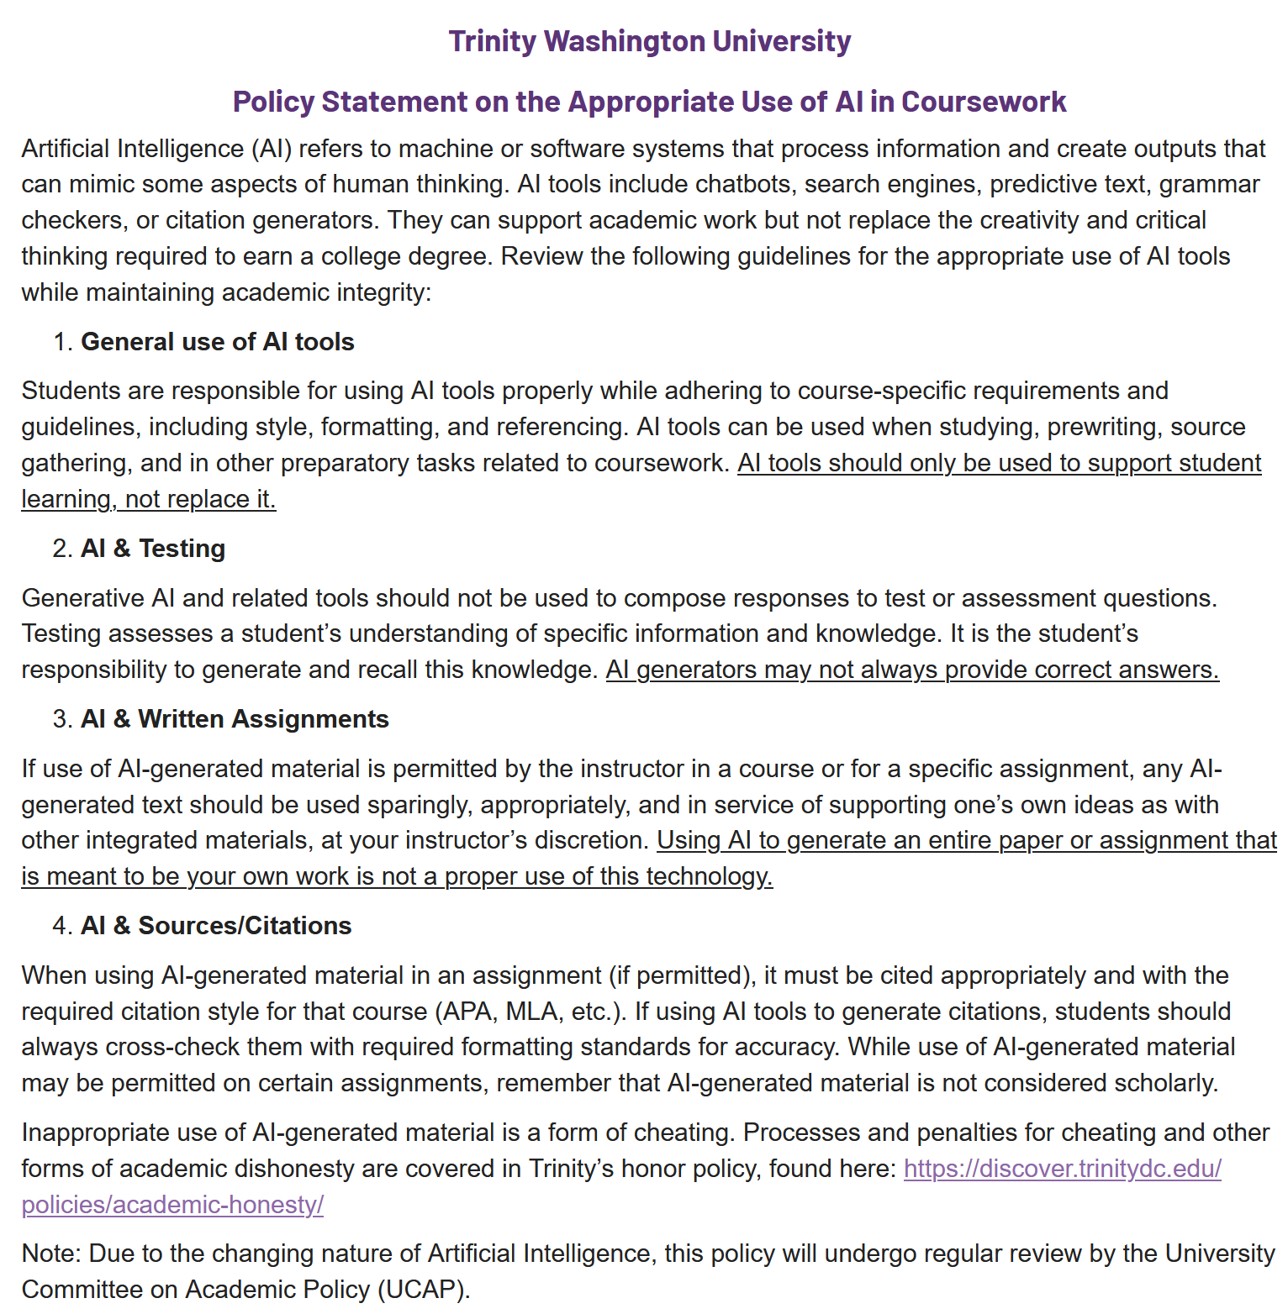
CURRENT

Slide 13
The following pages include summary results of the survey questions and select comments

Slide 14
How We Use AI Right Now
FACULTY | STAFF
General Communications Summarize lengthy texts Create Professional Photo Help with email tone and content | Improving Communications Proofreading Polishing emails Refining, editing text
PEDAGOGY Ideas for class discussion questions Ideas for labs and lectures Create study materials for students Draft exam questions for students Help explain concepts for students with different learning styles Creating powerpoints Develop Course materials | Project Management Documentation Program ideas Workshopping newsletter ideas Reviewing industry salaries (HR) Photo production
Cheating Detection Use “zerogpt” to check for student use of AI | Fact checking
Data Analysis | Data Gathering
Research Support Finding journals for publication | Funding support/proposals

Slide 15
FACULTY: I use ChatGPT (OpenAI) to support my work as a faculty member. I use it to brainstormideas, develop lesson plans and instructional materials, create classroom activities anddiscussion questions, refine assignment prompts, and draft communications such as emailsand announcements. AI is used as a productivity and instructional support tool, while all finaldecisions, course content, grading, and academic judgment remain my responsibility.
FACULTY: Yes. I regularly use artificial intelligence tools to enhance productivity, improve the quality ofmy work, and support both academic and administrative responsibilities. I primarily useChatGPT for drafting and editing communications, brainstorming ideas, summarizinginformation, developing course materials, data analysis, and research support. Grok Claude, problem-solving, and comparing AI-generated solutions to improve accuracy and efficiency.These tools serve as assistants (co-pilots) to streamline workflows while all final decisions,reviews, and approvals remain my responsibility.I also use and particularly for software development, coding assistance, debugging, technical
FACULTY: I intentionally do NOT use AI to plan lessons, grade papers, write recommendations, and do other professional tasks although I know the capacity is there. When I Google a question or term, the AI explanation is the first to pop up, so sometimes I look at that, but most often, I go to a more reliable source. Once in awhile I use it to summarize a source or concept. I usezerogpt.com to check for originality. I am frightened by AI.
STAFF: I use ChatGPT mainly to act as a supercharged search engine, as an initial fact-checkingdevice flag for actual follow up to check for grammar, clarity and AP style issues, and checksfor plagiarism and attribution. I have also generated images that do not violate intellectualproperty rights.I also use some of the AI features in the Adobe Creative Cloud suite for audioengineering, such as Adobe Podcast, which can fix audio issues. Photoshop now also has AItools that can assist in image development of photos.
STAFF: I actively avoid using AI in any capacity.

Slide 16
What we want to learn about AI:
FACULTY | STAFF
Process Improvements AI tools that can automate routine and repetitive tasks, improve workflow efficiency, organize information, and save time. How Anthropic's Claude Projects feature can support team collaboration, organize knowledge, and improve responses by working with shared organizational information. | Process Improvements More efficient processes Data organization and reporting Complex report generation Data visualization
Teaching Students About AI Ways to encourage students to see that AI is a tool, not a way to do their work. Use in identifying student areas of weakness to improve focus on topics implications of the use of AI for student learning outcomes How to teach students how to use AI ethically | Operational Issues HR: 1.Workforce Analytics and Retention2.Predictive Analytics 3.AI virtual assistance thathandles questions pertaining to PTO balances, benefits, company polices that provides instantsupport 4.Recruitment 5.On-boarding 6.Payroll Academics: Improved management of enrollments for course scheduling and support for major programs
AI in Curriculum and Pedagogy best practice in teaching AI use ethical AI use in literature synthesis teaching platform AI integration How to use AI as a resource to facilitate learning

Slide 17
FACULTY: I am quite averse to AI so have no interest in expanding its use in my work.
FACULTY: How to better fight its spread.
FACULTY: I would like to see guidelines around student information. I would be interested in having a do'sand don't's of AI use. Students' use of AI is not a solved problem here, and I do think that itneeds to be revisited. There should be a plagiarism flag and review process that is moredetailed with AI concerns at the forefront.
FACULTY (ADJUNCT): Studying AI is central to my professional role as a PreK-12 district leader. I'd like guidance forhow AI should be applied within higher education, beyond plagiarism and its consequences
STAFF: I'd like to know when it's going away.

Slide 18
Considerations for Policy Development
FACULTY | STAFF
Ethical Considerations Policy should state responsible use of AI, not prohibition Privacy: Protect information privacy of students and employees Transparency: Require users to identify AI generated work A policy should encourage transparency, protect privacy and confidential information, and promote AI as a tool that supports, rather than replaces, human judgment. | 1.Ensure Data Privacy2.Verify and edit before submitting or finalizing any documentation3.Disclose when AI is being utilized Ensure any use has final review and approval of the work by a human reviewer Transparency
Student Use of AI Clarify applications of AI for students whose first language is not English Clarify vague statements in the current AI policy Prohibit uploading student work into AI platforms for grading | Training for students, faculty and staff

Slide 19
FACULTY: I would recommend that Trinity adopt a policy that encourages the responsible use of AI ratherthan prohibiting it. The policy should require employees to protect confidential and studentdata, comply with FERPA and other privacy regulations, verify the accuracy of AI-generatedcontent before using it, and maintain human oversight for all decisions and officialcommunications. It should also provide guidance on appropriate AI tools, transparency whenAI is used for significant work products, ethical use, intellectual property considerations, andregular training to ensure faculty and staff can use AI effectively, securely, and responsibly.
FACULTY: I would expect that a policy would be created by a group that includes a fair representation of faculty and staff members who not only do not use AI but who have ethical and pedagogical objections to its training, implementation, rollout, and effects.
FACULTY: I think it should be very open. The use of AI will be so different in different fields and betweendifferent professors, and I also think that there is a wide array of different beliefs on what isright and what is wrong with regards to using AI. With any policy I think there needs to be aclear justification for why something is limited and a clear explanation of why it causes harm touse AI in that way. Generally, I think if the professor finds it helpful in their work and it is not actively causing harm or having a negative impact on their work then it should be allowed.
FACULTY: AI should not be used to create or generate academic or professional documents. AI should only be used as a research tool.

Slide 20
Additional Questions and Concerns
FACULTY | STAFF
Adopt specific platforms for use at Trinity | Adopt specific platforms
Have an ongoing university-wide committee | University-wide committee
More professional development for faculty on the responsible use of AI, and how to deal with student use that is inappropriate | Pay more attention to the environmental and other dangers and harms of AI, what its creators are really doing, impact on learning and brain development, ethical issues all over the placed

Slide 21
FACULTY: As Trinity develops its AI strategy, I encourage the institution to focus on providing secure,institution-approved AI platforms and comprehensive training for faculty and staff. AI adoptionshould be viewed as an opportunity to improve teaching, student support, research, andadministrative efficiency while maintaining strong standards for privacy, security, academicintegrity, and ethical use. Clear guidance on appropriate use cases, data governance,copyright, and human oversight will help employees use AI confidently and responsibly. I alsorecommend establishing a process to periodically review and update AI policies as thetechnology evolves, ensuring Trinity remains innovative while effectively managing risks.
FACULTY: I have no problem with how others use technology, but I will not be utilizing AI. I think it isnecessary for me to utilize the power of my own brain and creativity to make exams andlesson plans. I will not be allowing my students to use AI to complete exams or write papers.Whatever policy Trinity decides for use of AI, I don't think it should be mandatory in any capacity.
FACULTY: I believe Trinity should embrace AI more intentionally by integrating it into teaching, learning,and workplace practices. Rather than avoiding AI, we should equip both faculty and studentswith the knowledge and skills to use it ethically, responsibly, and effectively. Professionaldevelopment should focus on ethical use, privacy, bias, transparency, and understanding whenAI is an appropriate tool versus when independent critical thinking is essential. Our goal shouldbe to leverage AI to enhance learning and productivity without diminishing academic rigor,creativity, or the development of critical thinking skills.
FACULTY (ADJUNCT): It is really concerning that we do not have a plagiarism checker like Turnitin. While thesecheckers are imperfect, they help catch obvious cases of plagiarism and often AI. I work atseveral other institutions where we use this carefully and successfully. I can tell that some ofmy students at Trinity are using generative AI, but because we have no plagiarism checkers,it's impossible to do much about it. Because of this, I'm moving away from using technologyentirely. Trinity really needs to do something to address the fact that we're falling behind in ourability to deal with students plagiarizing and using AI.
FACULTY (ADJUNCT): As from above, 1) a updated and modern honors code tutorial that reflects the realities of AIand clarifying the bright line between AI as a tool and AI as a replacement2) A re-think ofwritten assignments -- with specific attention to assignments that are more oral than written. Inmy courses, I believe we are past the tipping point where written take home assignments arenow primarily created by AI and submitted as original work. I have asked my dean to changemy courses from virtual to hybrid/in-person so I have the option for in class monitoredperformance evaluations3) Many of Moodle's competitors have monitoring systems that trackif a student has opened another browser, or tripped an alarm which suggests they are usingnon-authorized resources when performing a task. I recognize this is much more invasive, andperhaps not in touch with our ethos. But many professional organizations, such as the CPAand bar use technology that monitors test takers to ensure they arent receiving inappropriatethird party help

Slide 22
Next page includes citations to select university policies, and those policies are also distributed in a separate document

Slide 23
AMERICAN UNIVERSITY: University Guidance on Responsible Use of AI https://ctl.duke.edu/ai-and-teaching-at-duke-2/artificial-intelligence-policies-in-syllabi-guidelines-and-considerations/
CATHOLIC UNIVERSITY: https://policies.catholic.edu/ai/index.html
COLUMBIA UNIVERSITY – Generative AI Policy https://provost.columbia.edu/content/office-senior-vice-provost/ai-policy
COLUMBIA UNIVERSITY – Approved AI tools https://www.cuit.columbia.edu/content/ai-services
DUKE UNIVERSITY – Artificial Intelligence Policies https://ctl.duke.edu/ai-and-teaching-at-duke-2/artificial-intelligence-policies-in-syllabi-guidelines-and-considerations/
GEORGE WASHINGTON UNIVERSITY: AI Use and Best Practices https://it.gwu.edu/ai-guidance-and-best-practices
HARVARD – Generative AI Guidelines https://www.huit.harvard.edu/ai/guidelines
HARVARD – Approved Tools https://www.huit.harvard.edu/ai/tools#general

