Slide 1
Assessing Students, Assessing Ourselves: Student Learning Outcomes as a Measure of Academic Effectiveness
Carlota Ocampo
September 25, 2013

Slide 2
Middle States Standards of Excellence: Standards 7 and 14
The fundamental question asked in the accreditation process is, “Is the institution fulfilling its mission and achieving its goals?” (p.26, MSCHE Characteristics of Excellence)
Assessment of student learning demonstrates that, at graduation, or other appropriate points, the institution’s students have knowledge, skills, and competencies consistent with institutional and appropriate higher education goals (p. 68)
Assessment must be “organized, systematized and sustained” (p. 27)
source: http://www.msche.org/publications/CHX06_Aug08REVMarch09.pdf

Slide 3
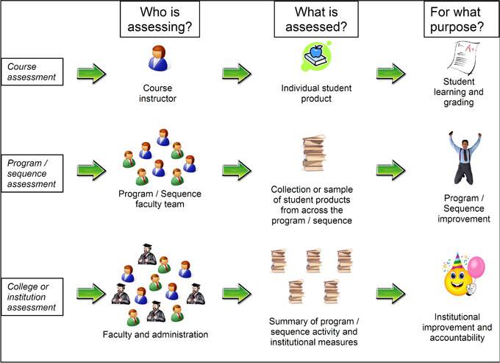
Levels of Assessment source: University of Nebraska -Lincoln Office of Assessment (PEARL) http://www.unl.edu/svcaa/pearl/assessment.shtml

Slide 4
The Assessment Cycle: Program Level source: University of Tennessee Knoxville Teaching & Learning Center, http://tenntlc.utk.edu/programmatic-and-course-based-assessment/
LEARNING OUTCOMES: What do your graduates know and care about? What can they do?
CURRICULUM: At what points in your curriculum to they acquire this knowledge and these skills?
ASSESSMENT: What assessments do you use to demonstrate knowledge and skills acquisition?
ANALYSIS OF RESULTS: What do the results of your analysis suggest? What are the programs’strengths and weaknesses? What should you change?
PROGRAM ENHANCEMENT: CLOSING THE LOOP is the most important aspect of the assessment cycle. Keep what works and adjust what does not.

Slide 5
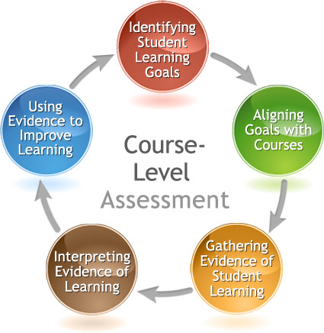
The Assessment Cycle: Course Level source: Columbia College Academic Assessment http://web.ccis.edu/en/Offices/AcademicAssessment/courselevel.aspx
Identify student learning goals for the course
Align teaching strategies and assessment methods with learning goals
Gather evidence: direct measures (assignments, grades) & indirect measures (student surveys, observations)
Interpret evidence: Are students prepared to move on in the curriculum?
Use evidence: Change course design, pedagogy, assignments, learning goals?

Slide 6
Statement of Mission: Trinity Washington University
Trinity is a comprehensive institution offering a broad range of educational programs that prepare students across the lifespan for the intellectual, ethical and spiritual dimensions of contemporary work, civic and family life. Trinity’s core mission values and characteristics emphasize:
Commitment to the Education of Women in a particular way through the design and pedagogy of the historic undergraduate women’s college, and by advancing principles of equity, justice and honor in the education of women and men in all other programs;
Foundation for Learning in the Liberal Arts through the curriculum design in all undergraduate degree programs and through emphasis on the knowledge, skills and values of liberal learning in all graduate and professional programs;
Integration of Liberal Learning with Professional Preparation through applied and experiential learning opportunities in all programs;
Grounding in the mission of the Sisters of Notre Dame de Namur and the Catholic tradition, welcoming persons of all faiths, in order to achieve the larger purposes of learning in the human search for meaning and fulfillment.
-Adopted May, 2000
Source: http://www.trinitydc.edu/mission/

Slide 7
Goals of the CAS General Education Curriculum
The college’s General Education Curriculum has seven goals:
Read, understand, and analyze texts
Communicate effectively in speech and writing
Understand and use quantitative reasoning to solve problems
Locate, evaluate, and synthesize information in the construction of knowledge
Explore and connect fields of knowledge in the liberal arts
Develop facility for moral reasoning and examine the moral and religious dimensions of human experience
Develop capacities for responsible citizenship and leadership in diverse communities

Slide 8
Program Review Assessment Plan: Suggested Format
Create/Refine Program Mission
Develop Program Goals (from mission)
State Objectives & Student Learning Outcomes Underlying Each Objective (from goals)
Identify Learning Opportunities for Each Objective/Outcome (Where in the curriculum does the learning occur?)
Establish Assessment Methods for Each Outcome (Direct & indirect)
Present Criteria by Which Outcomes Will be Judged (Rubrics? Ratings? Content analyses?)
Time Cycle for Review of Objectives and Related Outcomes
Who is Responsible for Coordinating the Assessment Process
Closing the Loop: How, When and By Whom the Data Will Be Used to Improve the Program or Revise the Curricula
*Adapted from Western Washington University's Tools & Techniques for Program Improvement and from the University of Hawai'i at Manoa's Assessment How-To Plan

Slide 9
Course and Program Assessment Tools
Curriculum mapping: http://uwf.edu/cutla/curriculum_maps.cfm
Bloom's Taxonomy http://ww2.odu.edu/educ/roverbau/Bloom/blooms_taxonomy.htm
Self-Scoring Teaching Goals Inventory http://fm.iowa.uiowa.edu/fmi/xsl/tgi/data_entry.xsl?-db=tgi_data&-lay=Layout01&-view

